Slide 1
The Relationship Between The Knowledge level and the Adherence on Vitamin D Self-Medication during Covid-19 Pandemic
SEKOLAH TINGGI ILMU FARMASI NUSAPUTERA (Nusaputera College of Pharmaceutical Science)
Scientific Paper
Health and Medical

Slide 2
Our Team:
Supervisor | apt. Metrikana Novembrina, M.Sc
Group leader | Pertiwi Setyaningrum
Group member | Marcia Angelica Vidigal Loi Pinto
Group member | Eli Ermawati

Slide 3
Content:
Chapter 1
Background and The Objective of The Study
Chapter 4
Result and Discussion
Studies of Vitamin D
Chapter 5
Chapter 3
Research Method
Chapter 2
Conclusion

Slide 4
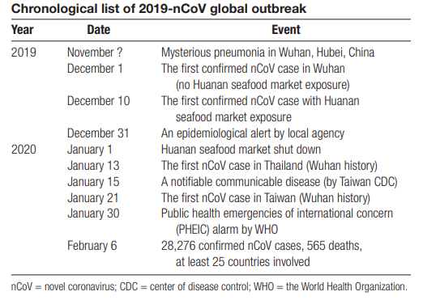
Chapter 1 Background
The outbreak of covid 19, starting from december 2019 to 2020
Vitamin D through some studies has been proven to be effective in maintaining body defense toward Covid-19
A study was needed to evaluate the knowledge of the participants on the ability of Vitamin D in maintaining the immune system and their adherence on Vitamin D self-medication.

Slide 5
The Objective of The Study
“Does The Knowledge of The Participants on Vitamin D significantly relate to their adherence on Vitamin D Self-Medication?”

Slide 6
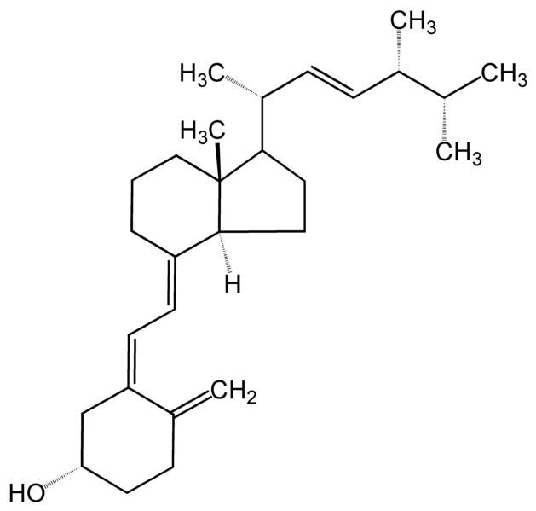
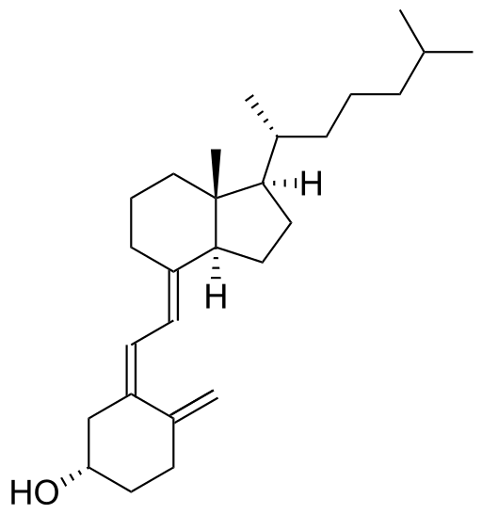
Chapter 2 :
Studies of Vitamin D towards Covid-19
A number of studies have stated that there is a positive relationship between well-fullfilled vitamin D needs and improving therapeutic outcomes in COVID-19 patients.
other studies suggest that those who are vitamin D deficient are more likely to experience COVID-19 symptoms than those who are vitamin D sufficient (Das et al, 2021).
Ergokalsiferol
Cholecalsiferol

Slide 7
Chapter 3
Research Method
This is an observational analysis study with a cross sectional method of 417 respondents in filling out a questionnaire.
The collected data was then analyzed by Chi-square test to see any difference in the proportion or relationship between the level of knowledge and compliance.

Slide 8
Participants :
Population | All of the participants who came to Kimia Farma 259 Pharmacy Store to buy the vitamin D.
Sample | Some of the participants who came to Kimia Farma 259 Pharmacy Store to buy the vitamin D, which were 417 participants.
The sample size was calculated by Slovin Formula :
n refers to the sample size
N refers to the population size
e refers to the margin of error

Slide 9
Chapter 4 Result and Discussion
Number | Characteristic | Amount | Percentage
1 | Age 18-28 29-39 40-50 51-61 62-72 | 23 71 119 178 26 | 6% 17,% 28,% 43% 6%
2 | Sex Male Female | 151 266 | 36% 64%
3 | Educational Background Elementary School graduate Junior high school graduate Senior high school graduate Diploma 3 graduate Bachelor degree graduate | 9 61 293 9 45 | 2% 15% 70% 2% 11%
4 | Work or Not Not in the workforce Housewife Private sector worker Goverment employees | 63 34 312 8 | 15% 8% 75% 2%

Slide 10
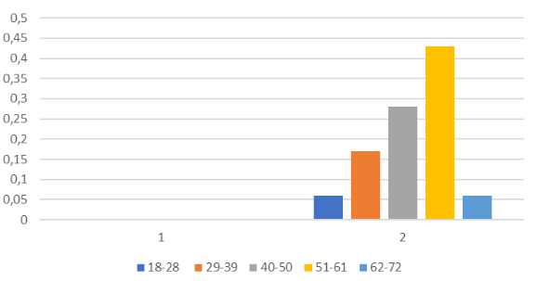
the range of age percentage of the participants
The graph shows that most of the participants were 51 to 61 years old.

Slide 11
Age
Based on the graph, it can be seen that ages above 50 to 60 years dominate the group of participants who visit the pharmacy store to buy vitamin D. This is due to a decrease in the production capacity of vitamin D by human skin along with the increasing age. In addition, doctors also prescribe vitamin D supplements with the aim of maintaining body immunity during the COVID-19 pandemic which has a very large impact on the elderly, especially for those who have comorbidities (Nanda et al, 2020).

Slide 12
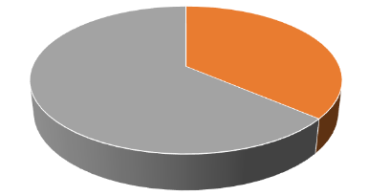
SEX
Based on the figure, it can be seen that the percentage of women who buy/ get a prescription for vitamin D as a supplement for bones is bigger than that of men.
male 36 %
Female 64 %
This is due to the influence of hormones on the number of incidence of osteoporosis
Beside that, it is stated that infected men are more likely to admitted to the Intensive Care Unit (ICU) and experienced mortality compared to women because women have an advantage in their immune system, namely: adaptive innate immune system as well as the differences in the number of X chromosomes (Peckham et al., 2020).

Slide 13
Chi-Square analysis results:
 |  | Compliance on Vit D self-medication |  | p-value
 |  | compliant incompliant
 |  | n % | n %
Knowledge level on vitamin D | high | 76 49.4 | 78 50.6
 |  |  |  | 0,000
 | low | 15 5.7 | 248 94.3
Total |  | 91 21.8 | 326 78.2
chi-square with Yates correction

Slide 14
Based on the chi-square analysis results, it can be seen that the percentage of compliance is greater in the group of respondents with a high level of knowledge (49.4%), compared to the group of respondents with low knowledge (15%).
A higher percentage of non-adherence to self-medication of vitamin D was also seen in the group with a low level of knowledge (94.3%), when compared to the group with high knowledge (50.6%).
The significance value was obtained > 0.05 (p-value = 0.000), meaning that there was a significant difference in the proportion between the two test groups.
So it can be said that there is a relationship between the level of knowledge and adherence to self-medication of vitamin D.
conclusion

Slide 15
REFERENCES
Das, P., Samad, N.,Ahinkorah, B.O., Hagan, J.E., Jr.,Peprah, P., Mohammed, A., Seidu,A.A. 2021.Effect of Vitamin D Deficiencyon COVID-19 Status: A SystematicReview. COVID. 1, 97–104. Farida Y., Salsabila Y.Z., Amsari A., NiruriR., Yugatama A., Handayani, N dan Prihapsara, P. 2021. Analisis Hubungan Pengetahuan Terhadap Kepatuhan Terapi Pada Pasien Hipertensi di Puskesmas Pucang Sawit Surakarta.Journal of Pharmaceutical Science and Clinical Research. V.03, 264-274 Hermawan, D. (2021). Manfaat Vitamin D pada Era Pandemi Covid - 19. Yogyakarta: Penerbit ANDI. Kemenkes RI. 2013. Riset Kesehatan Dasar; RISKESDAS. Jakarta: Balitbang Kemenkes RI. Kozier. (2010). Buku Ajar Praktik Keperawatan Klinis. Edisi 5. Jakarta : EGC Nanda, A., Vura, N.V.R.K. & Gravenstein, S. 2020. COVID-19 in older adults. Aging Clin Exp Res 32, 1199–1202 Notoatmodjo, S. (1993). Buku Pengantar Pendidikan dan Ilmu Perilaku Kesehatan. Yogyakarta: Andi Offset. ______. (2003). Pendidikan dan Perilaku Kesehatan.Jakarta: Rineka Cipta. ______. (2007). Promosi Kesehatan dan Ilmu Perilaku. Jakarta: Rineka Cipta Notoatmodjo, S. 2014. Promosi Kesehatan dan Perilaku Kesehatan.Rineka Cipta.Jakarta Octavia D.R.,Zakaria, M.S.,Nurafifah, D., 2019. Tingkat Pengetahuan Masyarakat Tentang Swamedikasi yang Rasional di Lamongan SURYA Vol. 11, No. 03, Desember.

Slide 16
REFERENCES
Putri, I.A.C. 2019. Gambaran Tingkat Pengetahuan dan Kepatuhan Konsumsi Tablet Kalsium pada Ibu Hamil di Poliklinik Kebidanan RSD Mangusada Kabupaten Badung. Diploma Thesis. Poltekkes Denpasar. Rahayu E.S, Wahyuni K., Raras A.P. 2021. Hubungan tingkat pengetahuan dengan kepatuhan pasien hipertensi di Rumah Sakit Anwar Sidoarjo. JIF Farmasyifa. 4 (1) : 87-97 RK, A.-A. R. A. A.-B. H. L. 2017. Prevalence of self-medication among university students in Baghdad: a crosssectional study from Iraq. East Mediterr Health, 23(2), 87–93. https://doi.org/10.26719/2017.23.2.87 Ruiz, M. 2010. Risks of Self-Medication Practices. Current Drug Safety, 5(4), 315–323. https://doi.org/10.2174/1574886107922 45966 Rusida, E.R., Adhani, R., Panghiyangani, R. 2017.Pengaruh Tingkat Pengetahuan, Motivasi dan Faktor Obat Terhadap Kepatuhan Minum Obat Pasien Hipertensi di Puskesmas Kota Banjarbaru. Jurnal Pharmascience.Vol. 04 , No.02, Oktober 2017, hal: 130 - 141 Sitindaon, L.A. 2020. Jurnal Ilmiah Kesehatan Sandi Husada hhttps://akper-sandikarsa.e-journal.id/JIKSH Volume 9, Nomor 2, Desember, pp 787-791 Tesch-Römer, C., Lamura, G. 2021. Older adults in the first wave of the Corona pandemic. Eur J Ageing 18, 145–147 WHO 2000. Guidelines for the Regulatory Assessment of Medicinal Products forUse in Self-Medication., Geneva.Available: http://apps.who.int/medicinedocs/pdf/s2218e/s2218e.pdf.Accessed December 10, 2013 Zhao, ZX., He, Y., Peng, LH. et al. 2021. Does vitamin D improve symptomatic and structural outcomes in knee osteoarthritis? A systematic review and meta-analysis. Aging Clin Exp Res 33, 2393–2403

Slide 17
TERIMAKASIH
Siang-siang pergi ke kota, Jangan lupa beli alpukat. Demikian presentasi kita, Semoga bisa bermanfaat.

